Slide 1
Galaxy Zoo
galaxy classification

Slide 2
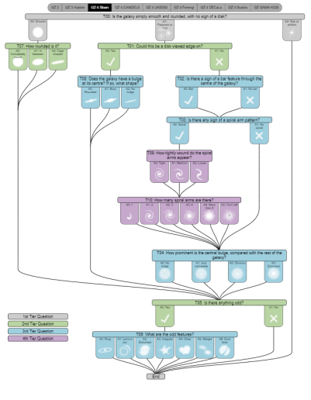
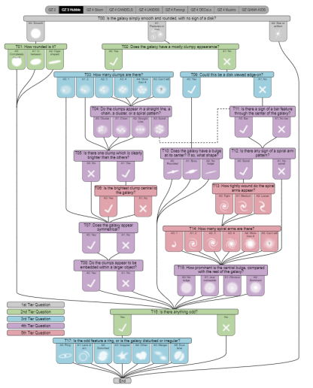
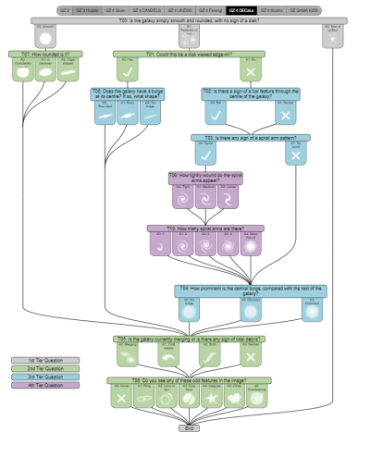
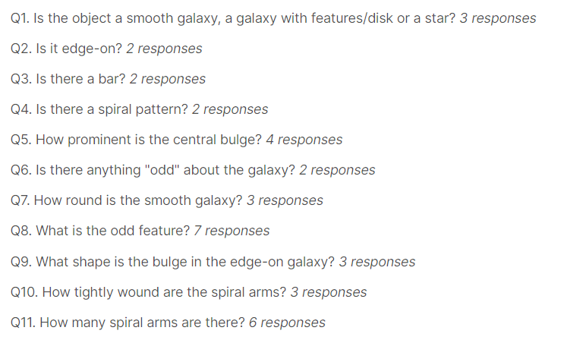
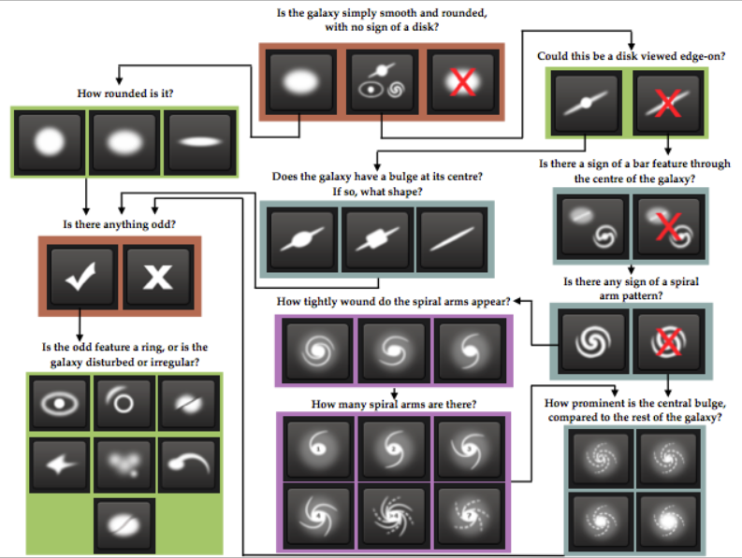
The challenge is to:
recognize the structure of the galaxy
classify galaxies by it’s photo

Slide 3



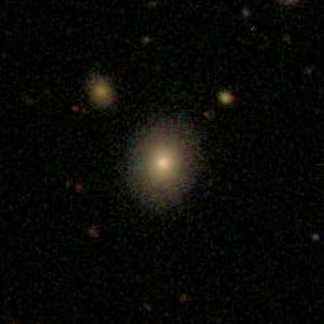
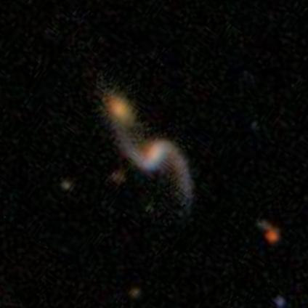
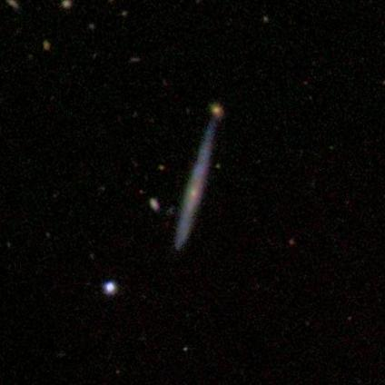
The dataset
Images of the galaxies from open source dataset of Sloan Digital Sky Survey manually labeled by volunteers in Galaxy Zoo project prepared for Kaggle Challenge
more than 60k galaxies images
every photo represents new different galaxy
RBGA jpeg images
424 x 424 pixels

Slide 4
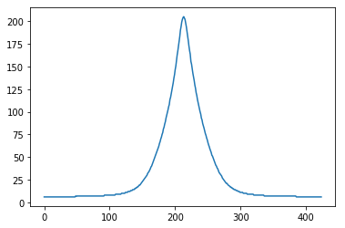
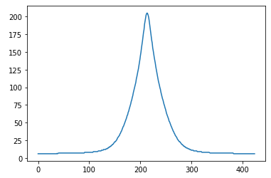
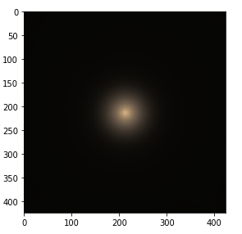
Preprocessing Data
Cumulative data presence on centre of y axis
Cumulative data presence on centre of x axis
All the galaxies photos are centered so we can rotate them without any data loss.
Most of the useful information is only in the centre of the photo
All photos were taken with the same filters, thus we don’t need to normalize their color

Slide 5
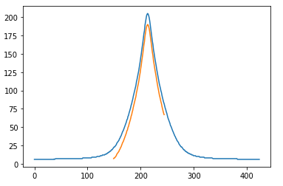
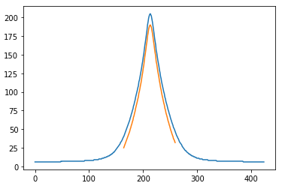
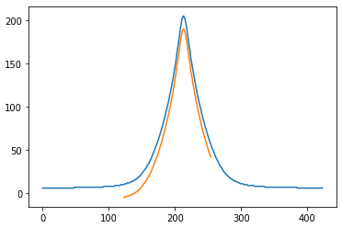
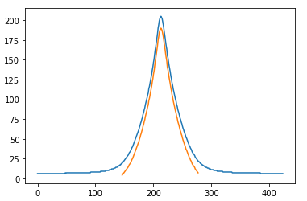
Preprocessing Data
We consider 4 ways to crop our pictures
two with crop size 96 pixels
and two with crop size 132 pixels
two centered
and two with offset relative to the center

Slide 6
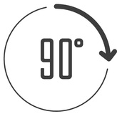



Preprocessing Data
As the dataset is quite small so we need to perform some augmentations to make it bigger and to train the model better
Before cropping the image we apply a random number of 90° rotations, random flipping and small-angle rotation to increase the reusability of each photo

Slide 7
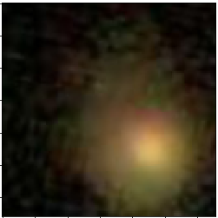
CNN
We were using two CNNs for different image sizes, but the main structure of them where the same.
Input
3x96x96
C4
128x8x8
S4
128x4x4
F1
128
D1
128
C1
16x92x92
S1
16x46x46
C2
32x44x44
C3
64x20x20
S2
32x22x22
S3
64x10x10
F2
37
MaxPool 2x2
MaxPool 2x2
MaxPool 2x2
MaxPool 2x2
Dropout
Convolution 5x5
Convolution 3x3
Convolution 3x3
Full connection
Full connection
Convolution 3x3
Input
3x132x132
C4
128x12x12
S4
128x6x6
F1
128
D1
128
C1
16x128x128
S1
16x64x64
C2
32x60x60
C3
64x28x28
S2
32x30x30
S3
64x14x14
F2
37
MaxPool 2x2
MaxPool 2x2
MaxPool 2x2
MaxPool 2x2
Dropout
Convolution 5x5
Convolution 3x3
Convolution 3x3
Full connection
Full connection
Convolution 5x5

Slide 8
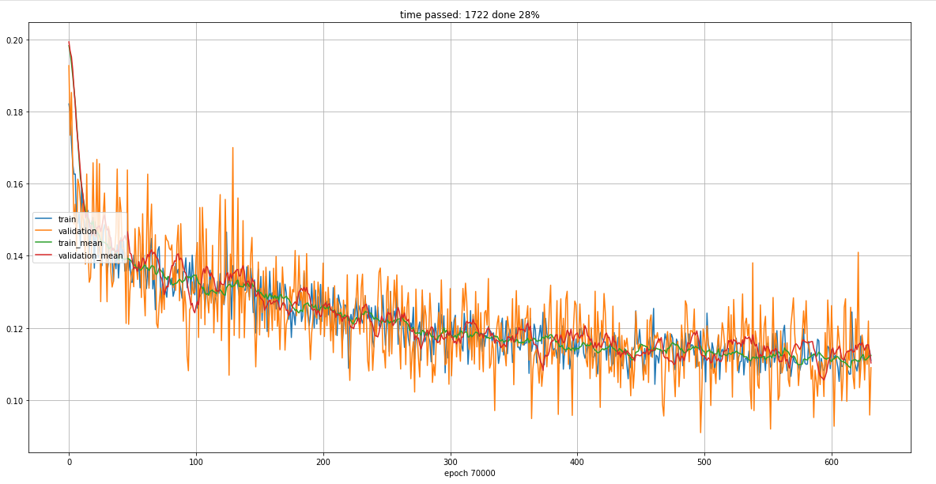
Results
I managed to achieve rmse at value 0.115 which is 94-th place in Kaggle leaderboard (bronze)
The best model was the simplest one (and the one that was trained on the same data most times)
The other models scored around 0.12.
When models were training I never was able to train to the moment when validation loss differ from the train one.
This mean that the model wasn`t fully trained.

Slide 9
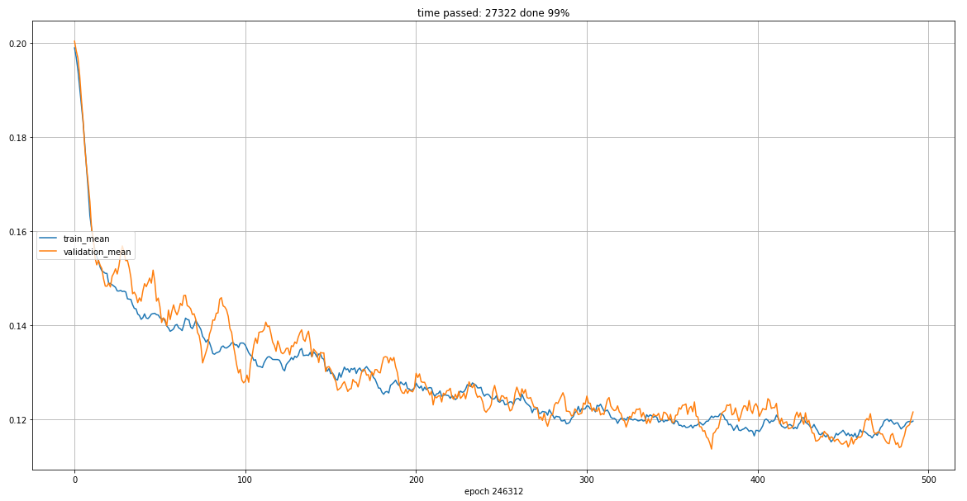
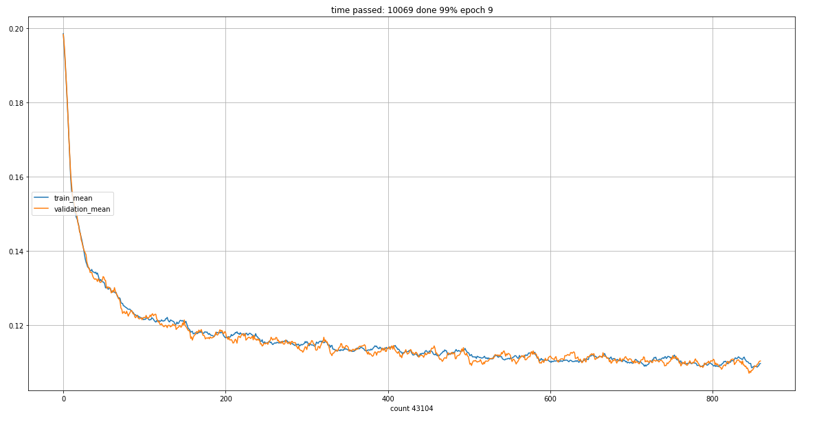
Results
As expected models that were training on larger picture had much bigger training time (around 4-6 times longer in comparison to smaller but they didn`t result in better score.

Slide 10
Results
As expected models that were training on larger picture had much bigger training time (around 4-6 times longer in comparison to smaller but they didn`t result in better score.
Models that were training on centred have smaller learning rate than other that were training with some offset.

Slide 11
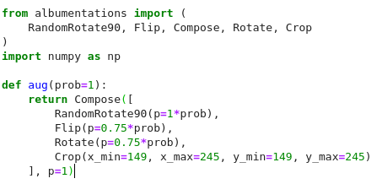

Results
When I started using albumentations library training time has doubled. Thus, sometimes it’s better to use pure numpy or torch.tensor than other libraries, when training time matters a lot.

